Slide 1
OLAP Operations

Slide 2
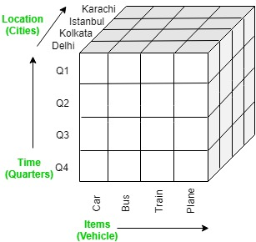
It is a software technology that allows users to analyze information from multiple database systems at the same time. It is based on multidimensional data model and allows the user to query on multi-dimensional data (eg. Delhi -> 2018 -> Sales data). OLAP databases are divided into one or more cubes and these cubes are known as Hyper-cubes.

Slide 3
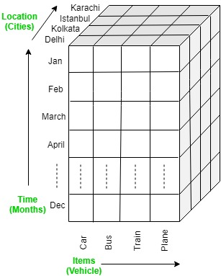
OLAP operations:
There are five basic analytical operations that can be performed on an OLAP cube:
Drill down: In drill-down operation, the less detailed data is converted into highly detailed data. It can be done by:
Moving down in the concept hierarchy
Adding a new dimension
In the cube given in overview section, the drill down operation is performed by moving down in the concept hierarchy of Time dimension (Quarter -> Month).

Slide 4
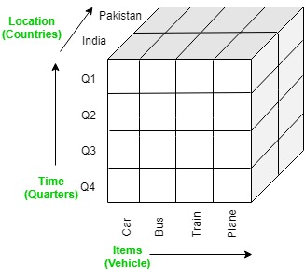
Roll up
It is just opposite of the drill-down operation. It performs aggregation on the OLAP cube. It can be done by
Climbing up in the concept hierarchy
Reducing the dimensions
In the cube given in the overview section, the roll-up operation is performed by climbing up in the concept hierarchy of Location dimension (City -> Country).

Slide 5
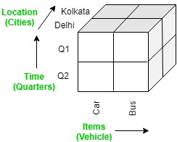
Dice
It selects a sub-cube from the OLAP cube by selecting two or more dimensions. In the cube given in the overview section, a sub-cube is selected by selecting following dimensions with criteria:
Location = “Delhi” or “Kolkata”
Time = “Q1” or “Q2”
Item = “Car” or “Bus”

Slide 6
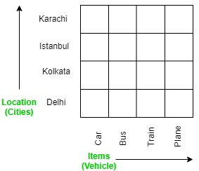
Slice: It selects a single dimension from the OLAP cube which results in a new sub-cube creation. In the cube given in the overview section, Slice is performed on the dimension Time = “Q1”.
Slice:
It selects a single dimension from the OLAP cube which results in a new sub-cube creation. In the cube given in the overview section, Slice is performed on the dimension
Time = “Q1”.

Slide 7
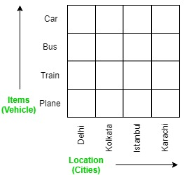
Pivot:
It is also known as rotation operation as it rotates the current view to get a new view of the representation. In the sub-cube obtained after the slice operation, performing pivot operation gives a new view of it.

